Slide 1
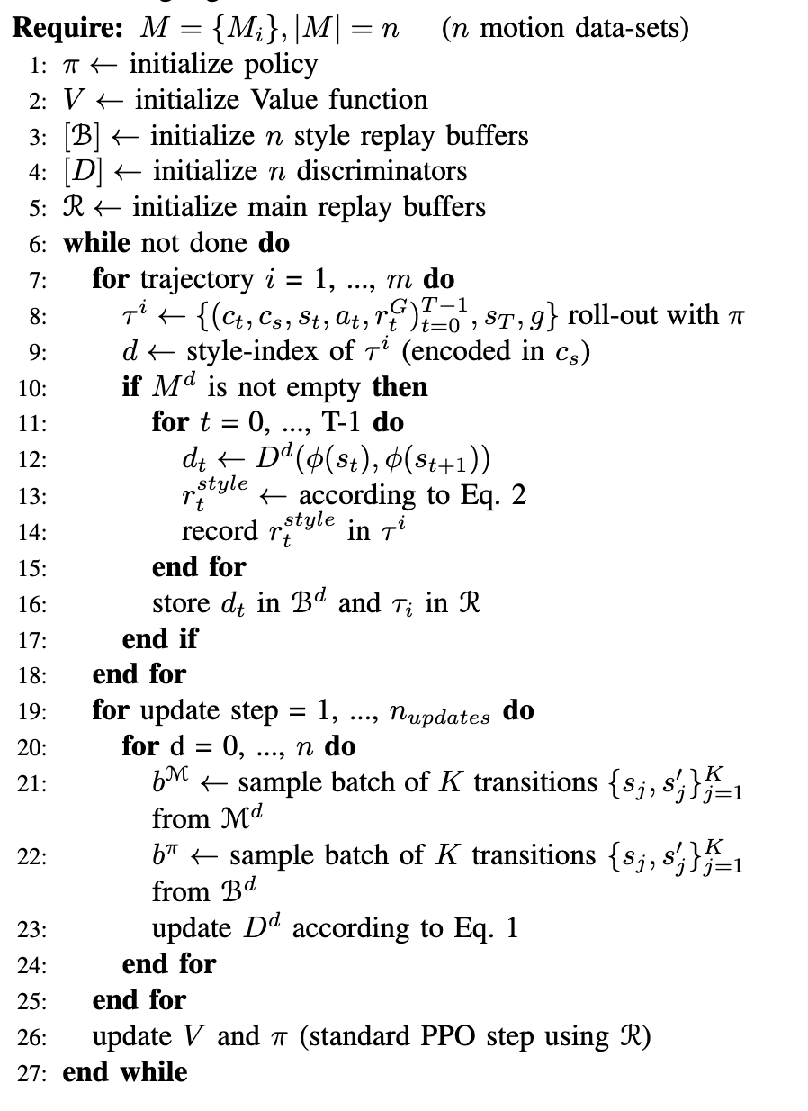
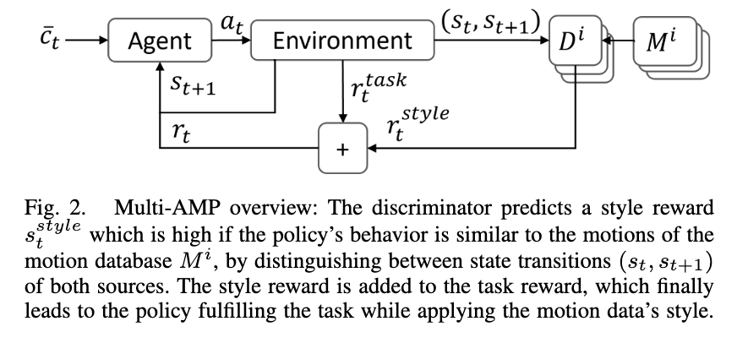
Advanced Skills through Multiple Adversarial Motion Priors in Reinforcement Learning

Slide 2
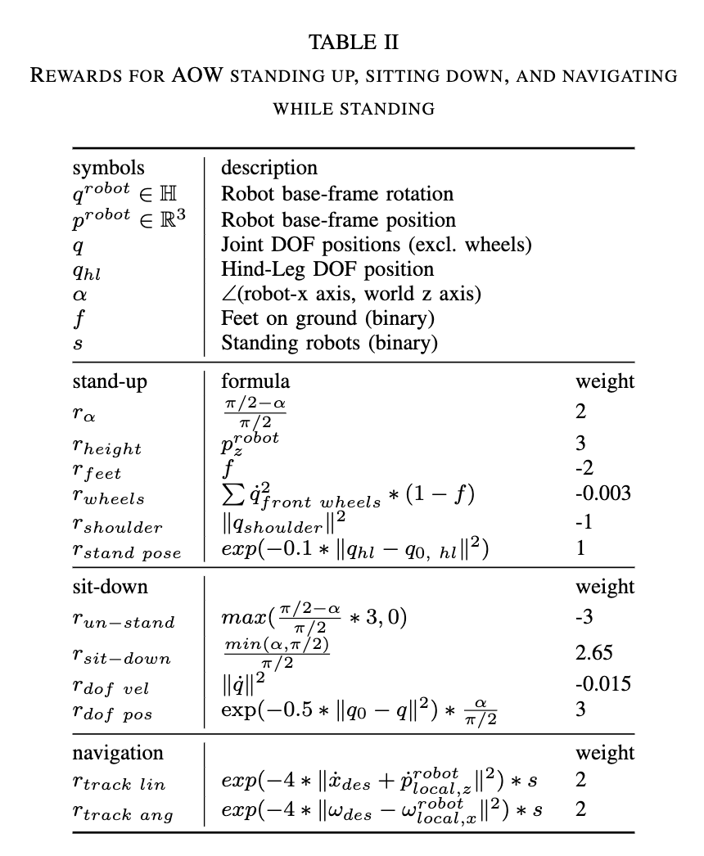
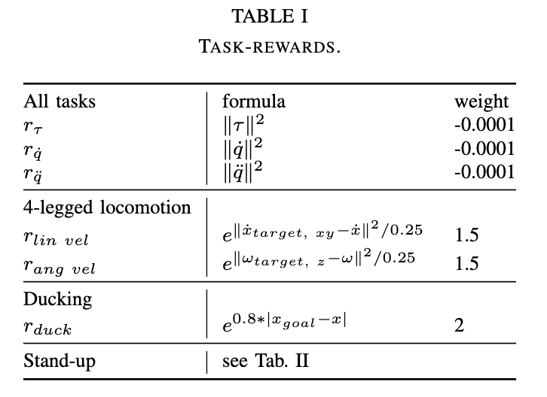
Advanced Skills through Multiple Adversarial Motion Priors in Reinforcement Learning

Slide 3
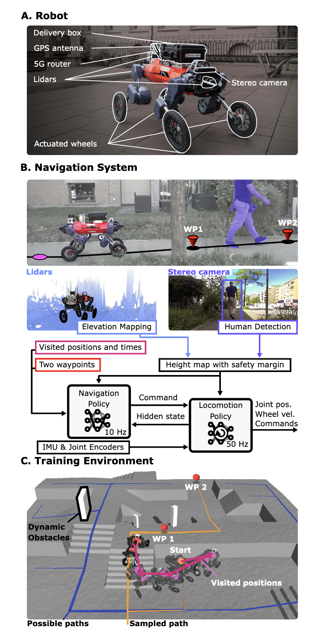
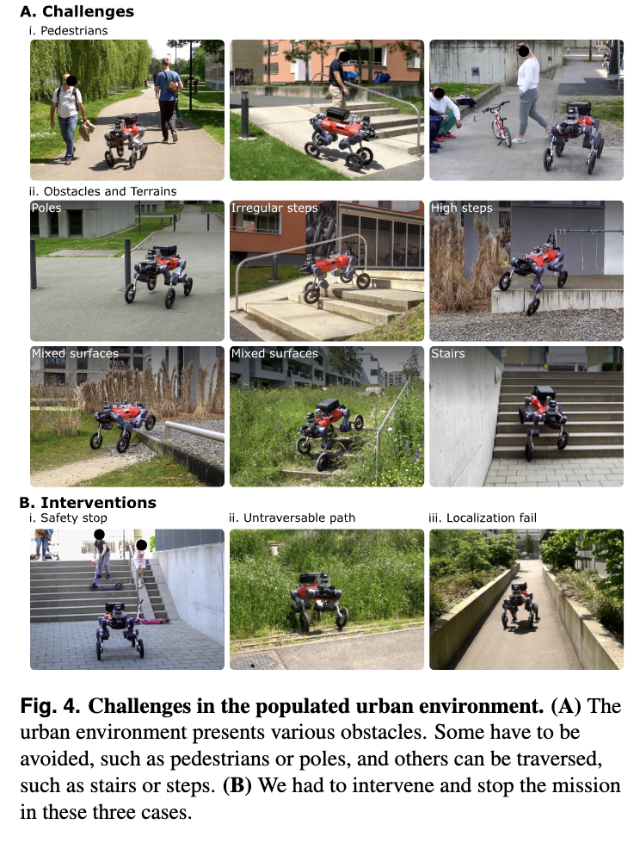
Learning Robust Autonomous Navigation and Locomotion for Wheeled-Legged Robots

Slide 4
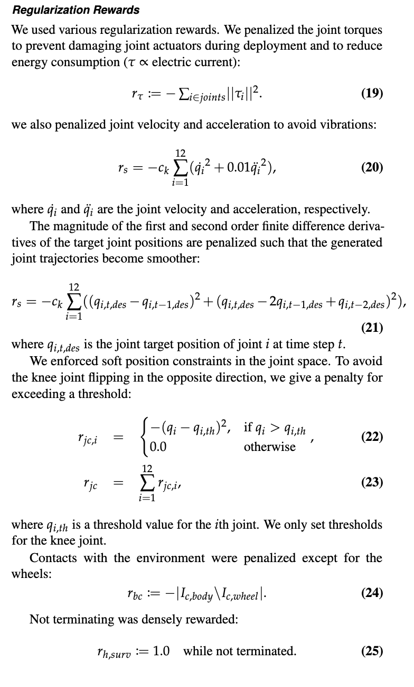
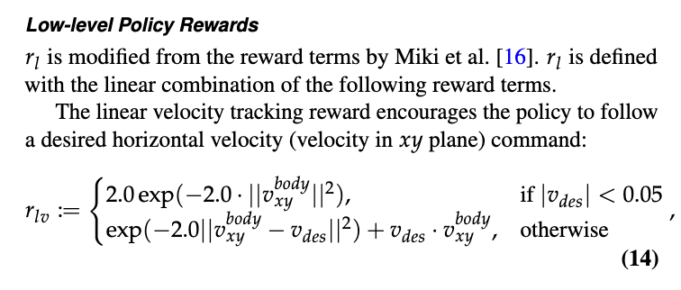
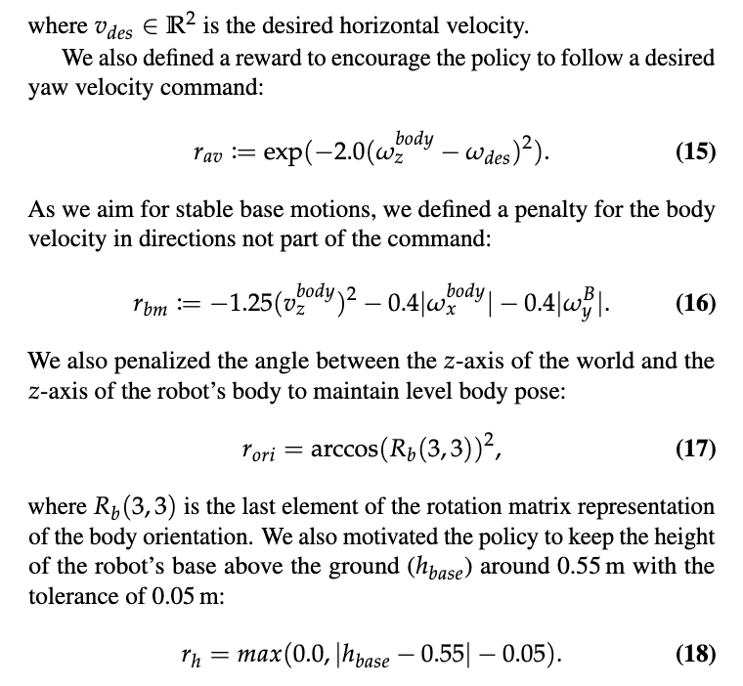
Learning Robust Autonomous Navigation and Locomotion for Wheeled-Legged Robots

Slide 5
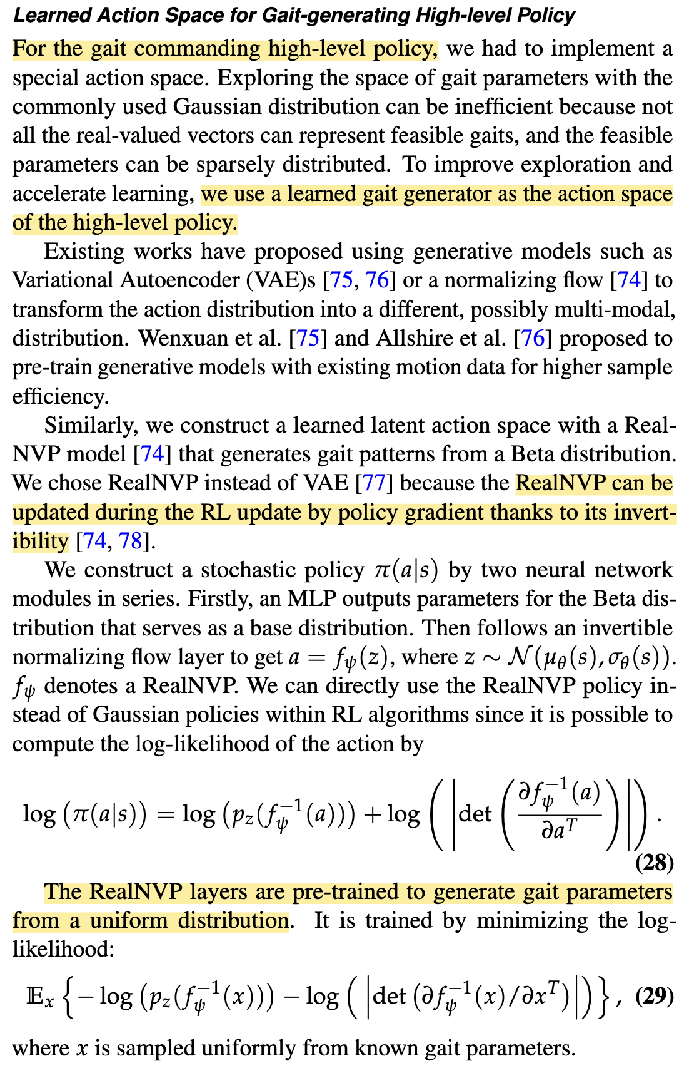
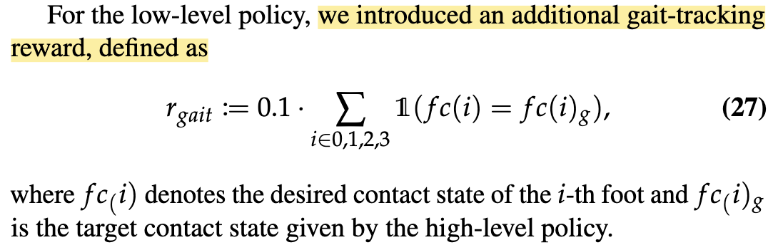
Learning Robust Autonomous Navigation and Locomotion for Wheeled-Legged Robots

Slide 6
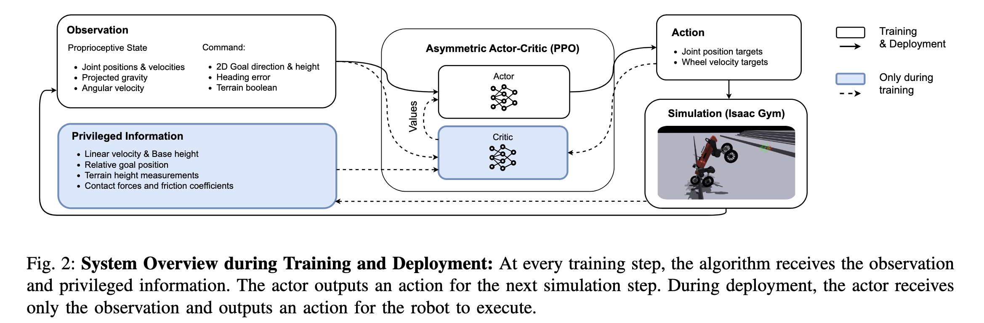
Reinforcement Learning for Blind Stair Climbing with Legged and Wheeled-Legged Robots

Slide 7
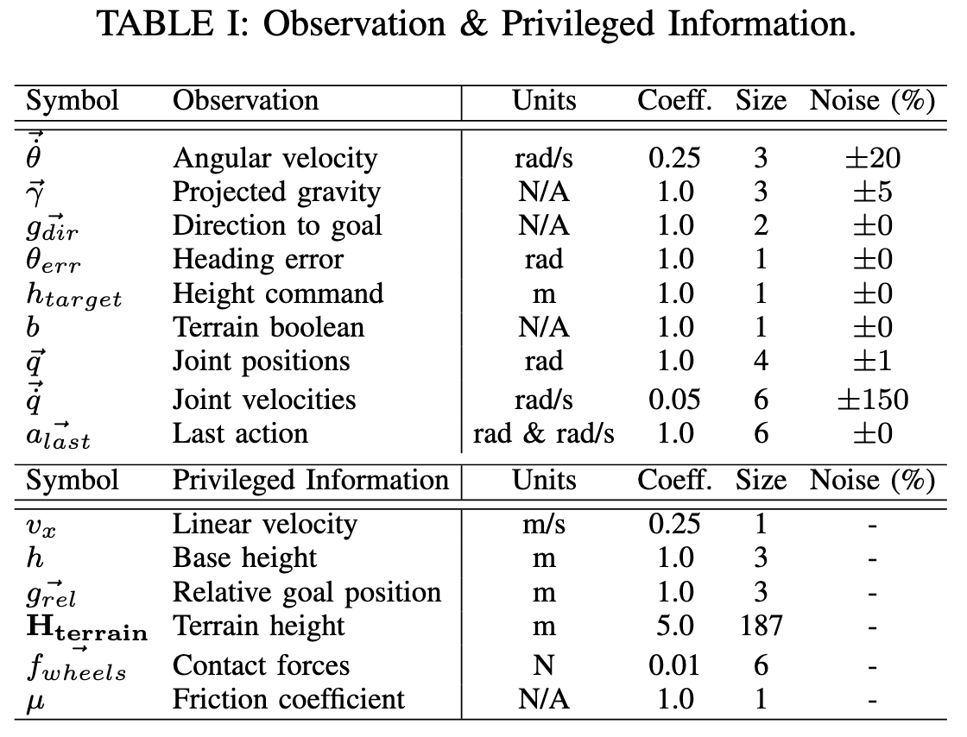
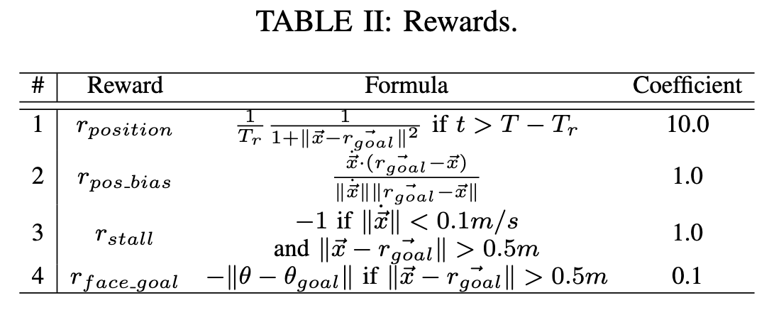
Reinforcement Learning for Blind Stair Climbing with Legged and Wheeled-Legged Robots

Slide 8
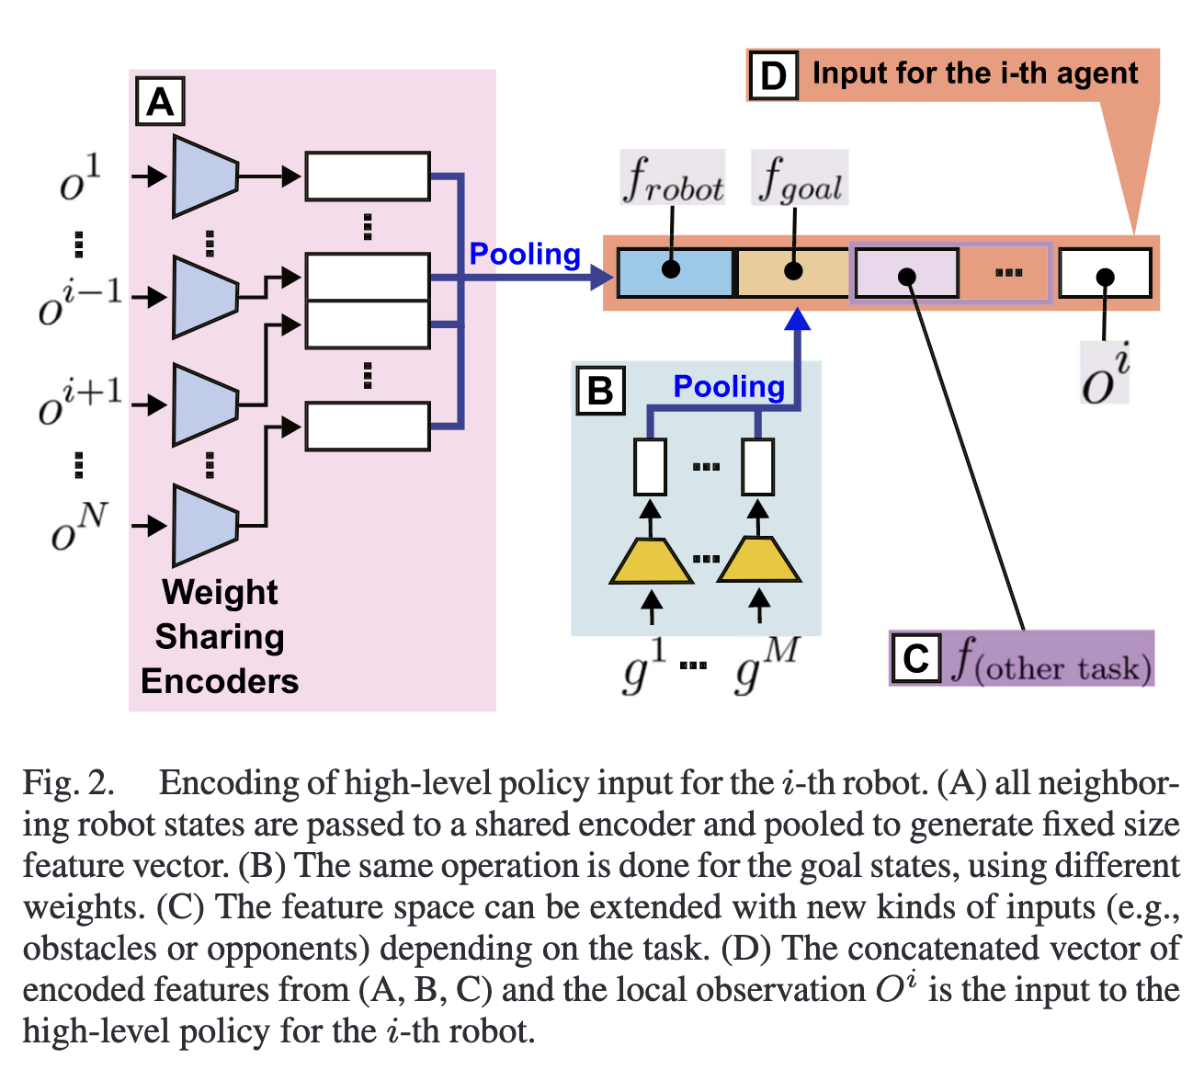
Scalable Multi-Robot Cooperation for Multi-Goal Tasks Using Reinforcement Learning

Slide 9
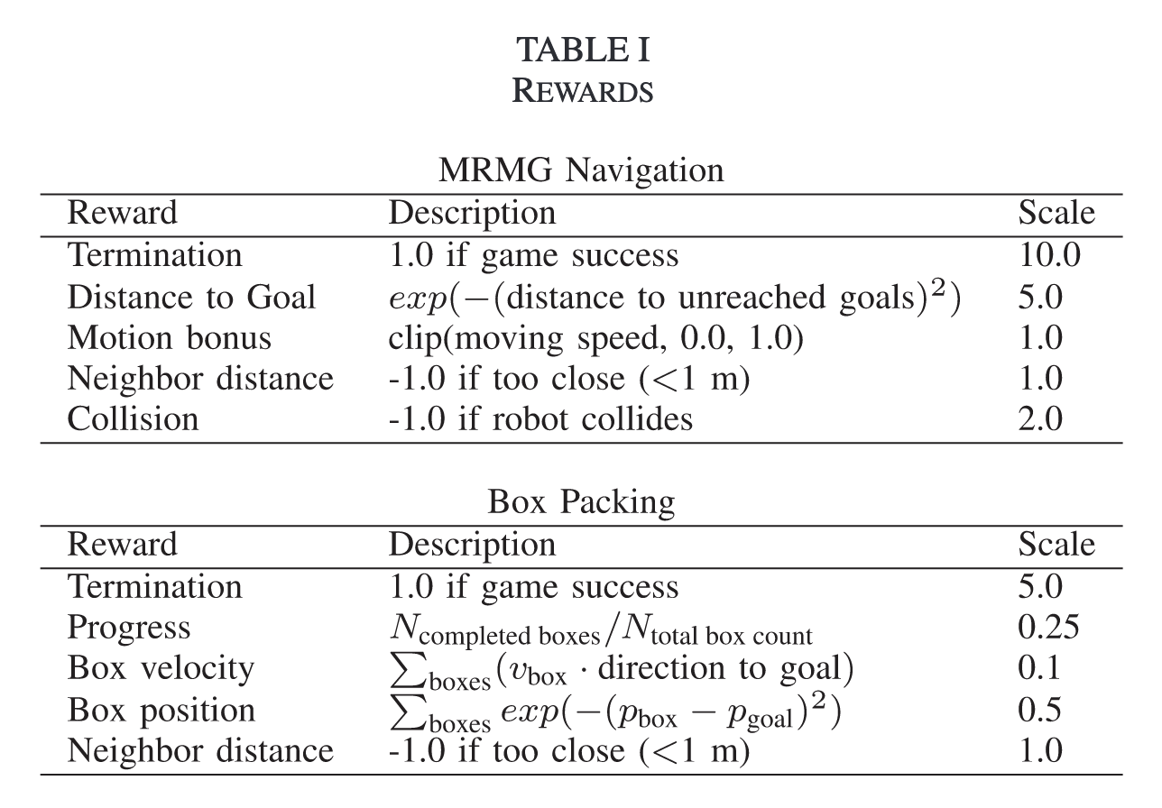
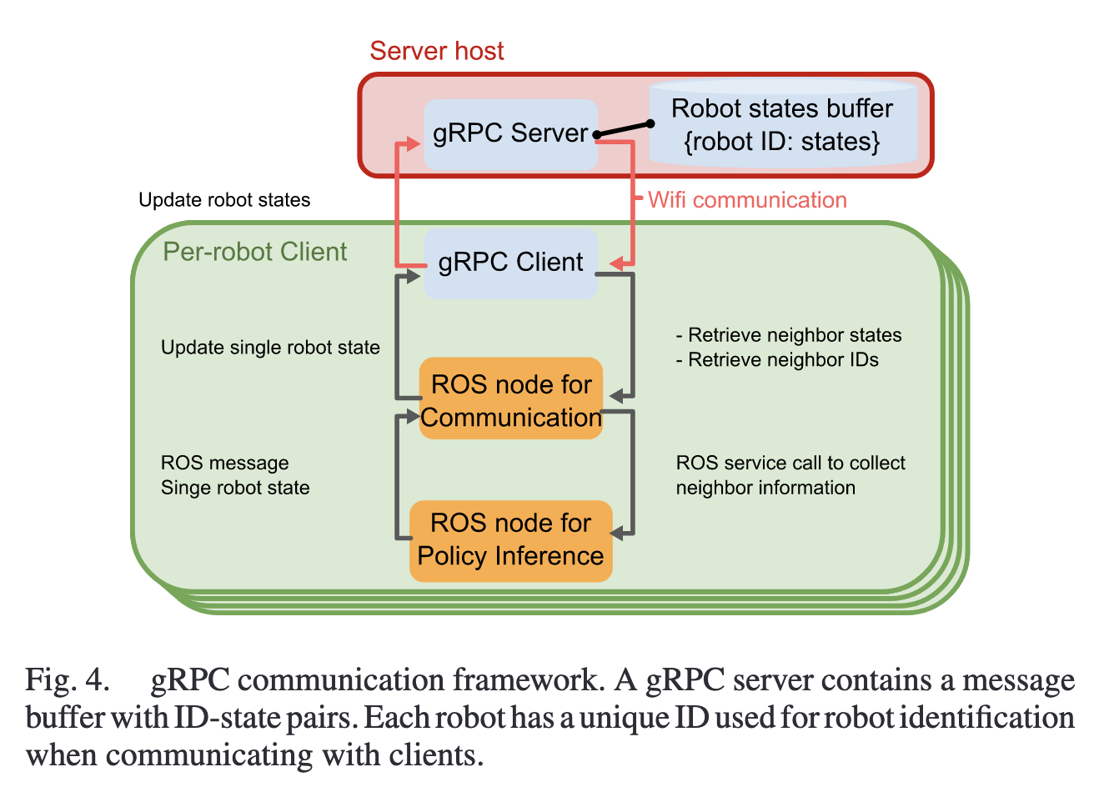
Scalable Multi-Robot Cooperation for Multi-Goal Tasks Using Reinforcement Learning

Slide 10
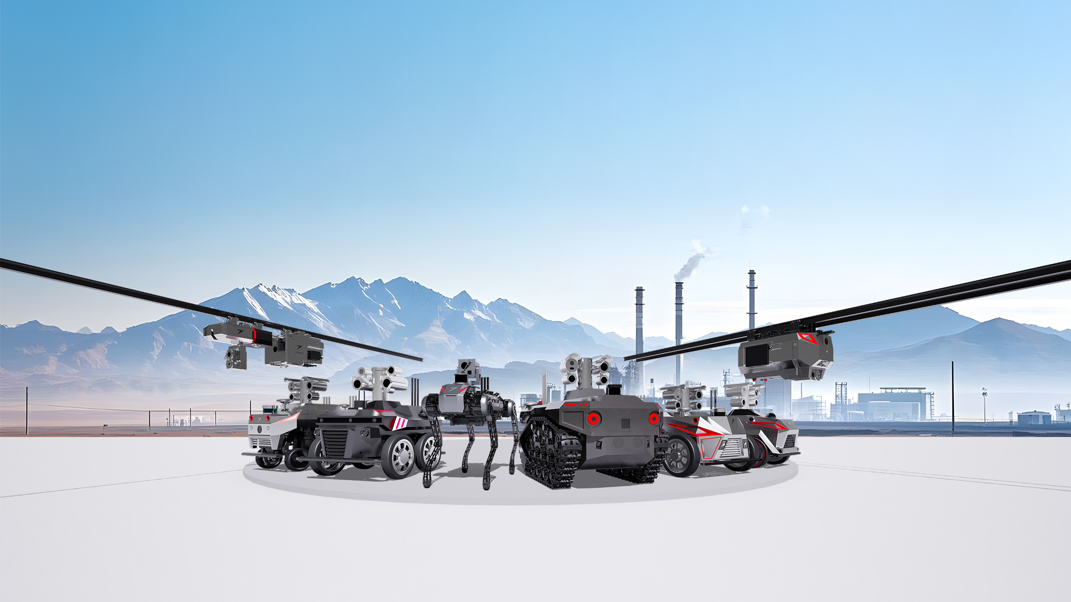
Thank you

